Slide 1
MGT 388 Finance and Law for Engineers
Introduction

Slide 2



Module Aim
Module aim to introduce engineering students to key aspects of management which they are likely to experience in their future careers.
Aspects considered relevant by the Engineering Faculty and accreditation bodies.

Slide 3

Module Assessment

Slide 4
Module Assessment - Finance
The Finance component of the module is 50% of the module assessment and is assessed by:
1 hour 30 minute end of module exam
Answer 2 questions from 3
Questions will assess more than one area of the syllabus
You must attend, prepare and revise everything
Previous exam papers will be available on MOLE.

Slide 5
Organisation of Module - Finance
The finance component is taught via:
Weekly 1 hour lecture (weeks 1-10)
Two tutorials (Either weeks 3&7 or 4&8)
Revision tutorials (weeks 11&12)

Slide 6
Learning Materials
Mole is organised weekly. Each week you should find:
Power point slides
Lecture notes with guided reading
Questions and answers
There is also a Tutorial Folder for the tutorials to be held in weeks 3/4 and 7/8. These questions MUST BE completed before attendance and answers will be added to the folder at the end of weeks 4 and 8.
All files will also be reproduced as a PDF

Slide 7

Module Content
Week One – Introduction
Weeks 2-4 Financial Accounting
Understanding and interpreting a set of annual accounts.

Slide 8


Module Content
Weeks 5-7 Management Accounting
How to cost a product or service.
Pricing decisions.
Short term decisions.
Weeks 8-9 Financial Management
Long term decisions
Sources of finance
Week10
Review

Slide 9



Definition of Accounting
The process of identifying, measuring and communication economic information to permit informed judgements and decisions by users of the information.

Slide 10

Financial Accounting
Provides information to users outside the organisation. The information is contained in an Annual Report and is published by the organisation.
Assumes users have some business and accounting knowledge

Slide 11


Financial Accounting
Provides information about the financial position.
That is things an organisation owns and owes. Manchester United – Stadium and debts

Slide 12


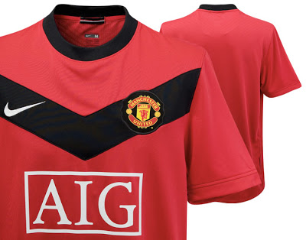


Financial Accounting
Provides information about the financial performance.
That is the profit the organisation is making.
Manchester United ticket sales, sponsorship, shirt sales, TV rights player salaries and interest payments.

Slide 13









FINANCIAL ACCOUNTING

Slide 14
Uses of Financial Accounting
Investing in shares – will there be dividends?
will the share price go up?
Buying or selling to another company assess reliability for payments or delivery, ethical standards
Seeking employment-wages and salaries, staff retention, directors pay, social responsibility, future plans.
Governments – tax revenue, executive pay, diversity, social responsibility.

Slide 15
Which of the following would NOT appear in a set of company accounts
The profit earned in the year.
The cash position at the end of the year.
Sensitive information which is not known by competitors.
The future plans of the company.

Slide 16






MANAGEMENT ACCOUNTING

Slide 17
Management Accounting
The management accountant is responsible for:
Determining the relevant information.
Collecting the information
Communicating the information
Incentives to achieve objectives
Monitoring achievement of objectives and highlighting any cause for concern.
The directors are responsible for making decisions based on information provided.

Slide 18




Management Accounting
BPP – Profit maximisation
Risk assessment technical and geographical.
Ford – Research and development in UK production elsewhere in the World.
Apple – General economic information, price,
Technology and competition.
Nearly all decisions require non-financial information and the information will be based on estimates as the decision relate to future actions.

Slide 19
Relevance of Management Accounting To You
Entrepreneur
What are your relevant costs and what price should you charge?
Employed
Understand the information being supplied to you.
Collect and monitor costs of a project you are responsible for.
Understand how to choose between alternative products or processes.

Slide 20
The management accountant for a computer retailer is responsible for determining if a store is financially viable
True
False

Slide 21



FINANCIAL MANAGEMENT
Takeover
Funds available
Bank? Shares? Partner?
Organic growth

Slide 22

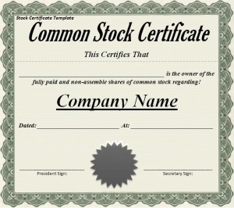
Financial Management
Financial management is concerned with
How a business operates:
Sole Trader
Partnership
Company – Limited/Plc
How funds for a business are raised
Overdraft
Loan
Issue shares

Slide 23


Financial Management
How funds are used.
New factory
New company
New project

Slide 24
Loan V Shares
In a company any profit made at the end of the year belongs to shareholders.
Although all the profit generally does not get distributed to the shareholder it does belong to them.
The larger the profit the more the shareholders may receive.
If a company needs more funding it could take out a loan and pay interest which will reduce profits or ask shareholders for more money.
A loan may be quicker, easier and cheaper BUT:

Slide 25
Profits and Interest Payments
A company has been making profits before interest of £8 million and has to make interest payments of £3 million.
If the profits before interest falls by 20% by what percentage will profit after interest fall by?

Slide 26
Profit after interest will fall by
20%
32%
50%

Slide 27
The End
Please review slides and more comprehensive lecture notes.

